Slide 1
ACCOUNT EXECUTIVE PERFORMANCE SUMMARY
Notes:
Presentation updated: February 28, 2020

Slide 2

together.
Notes:
Review of the mission and vision of the company.
Connection to the personal value of each employee

Slide 3

ACCOUNT EXECUTIVE REVIEW
Notes:
The goals of today’s presentation:
Review of benchmark data (salary and commission)
Review of top performers from each category
Account Executive I
Account Executive II
Account Executive III
Increasing Revenue Strategies
Strategy 1: Assume consistent compensation structure and no growth in headcount. Optimize by assuming company grows its book of business.
Strategy 2: Modify the pay structure to boost incentives for employees & maximize net revenue.
Strategy 3: Increase the headcount
Combining all strategies

Slide 4
BASE SALARY RANGE, QUOTA, HEADCOUNT
Title | Base Minimum | Base Maximum | Quota | Headcount
Account Executive I | $ 30,000 | $ 65,000 | $ 500,000 | 310
Account Executive II | $ 50,000 | $ 80,000 | $ 600,000 | 343
Account Executive III | $ 75,000 | $ 125,000 | $ 750,000 | 347
*based on 1,000 employees
Notes:
Review the minimum and maximum range for salary at each position
Review the expected quotas for each position
Quick summary of headcount at company for each executive level

Slide 5
CURRENT COMMISSION STRUCTURE
Title | 0-100% | 100-125% | 125-150% | 150-200% | >200%
Account Exec I | 10% | 15% | 18% | 22% | 10%
Account Exec II | 13% | 17% | 21% | 26% | 13%
Account Exec III | 15% | 19% | 23% | 30% | 15%
Notes:
Just a snapshot of the current commission structure based on job title and total sales.

Slide 6

celebrate our climb.
Notes:
Review of the mission and vision of the company.
Connection to the personal value of each employee

Slide 7
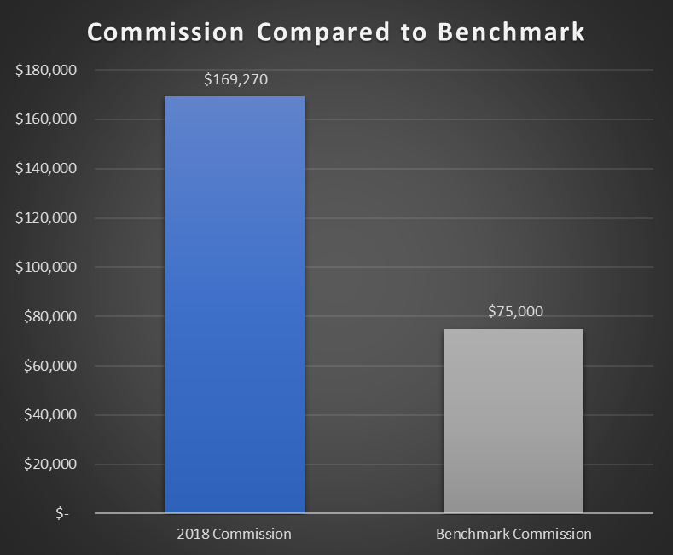
Top Performers – Account Executive I – Nathalie Bowerbank

Slide 8
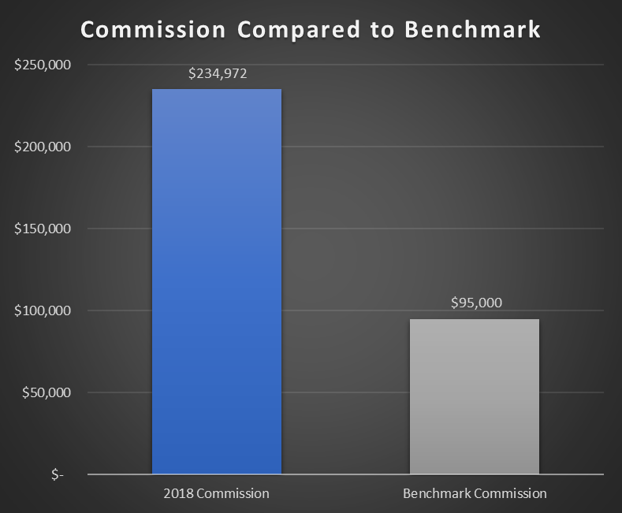
Top Performers – Account Executive II – Darryl Worgan

Slide 9
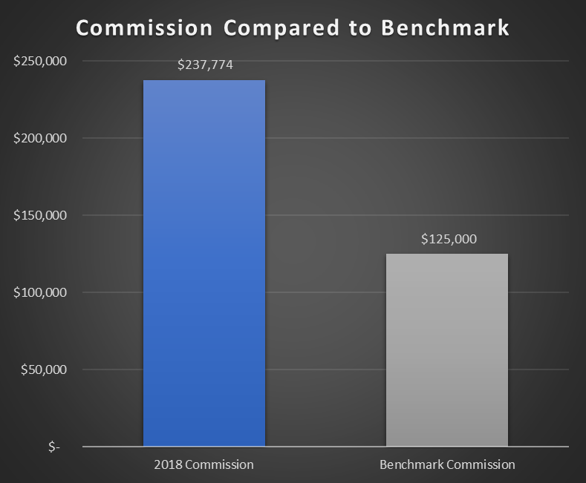
Top Performers – Account Executive III – Shaylynn Southern

Slide 10
$699,144,198
Current Gross Revenue
Notes:
Current gross revenue

Slide 11
$1,116,101,518
How do we get here?
Notes:
Talk about the current gross revenue based on current model which is roughly 700,000,000
Actual number – 699,144,198

Slide 12
1% INCREASED COMMISSION
$67,000,000
A
Notes:
Explore the idea of increasing commission by 1% with the goal of:
Increased motivation
Increased sales
This would be the additional revenue from an incentive to employees to work harder to earn higher commission based on total sales

Slide 13
ADDITIONAL EMPLOYEES
$140,000,000
B
Notes:
Current hires – 1,000
Increase to – 1,200

Slide 14
INCREASE ACCOUNTS CLOSED
$210,000,000
C
Notes:
Explore the idea of increasing total accounts closed from 20,000 to 26,000 per year
Remind that this is through:
no additional incentives
changes to pay
changes to commission structure
This would be the additional revenue from a flat out increase of additional sales

Slide 15
COMBINED STRATEGIES TOTALS
$67 million – increase commission
$140 million – increase employees
$210 million – increase accounts
$417,000,000

Slide 16
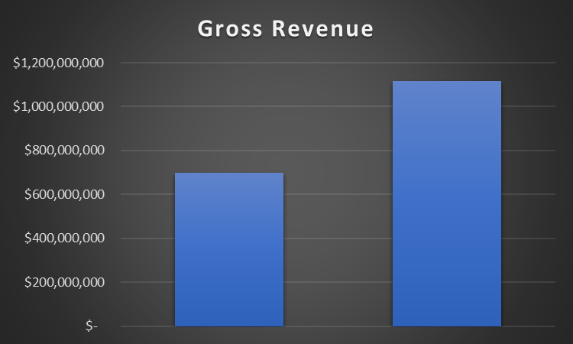
Totals with Combined Strategies

Slide 17

Questions?

